Slide 1
Theme For Internship
■Theme
Evaluate Accuracy of Image Searching Engine
■Activity
・Learning the problems of current Image Search Engine
・Learning CNN（Convolutional Neural Network）,Chainer
・Learning Current Image Search Engine
・Evaluate Accuracy of Current Image Search Engine
・Update Current Image Search Engine
・Evaluate Accuracy of Updated Image Search Engine
・Make Survey Report
■Your Outcome
・Survey Report
■Requested Skill
・python

Slide 2
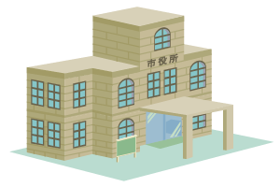
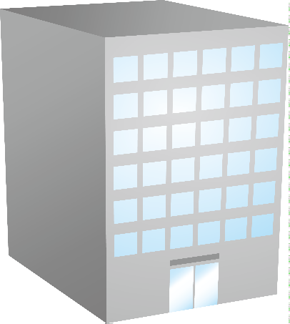




Image Search Engine
Patent Office
Company
Apply For Trademark Right
Results of Screening
Image Search Engine
Search
Employees working at the Patent Office use Image Search Engine to Search for similar trademarks.

Slide 3
schedule
date | Activities
6/5 | orientation
6/6～6/9 | Learning the problems of current Image Search Engine Learning CNN（Convolutional Neural Network）,Chainer
6/12～6/16 | Learning Current Image Search Engine
6/19～6/23 | Evaluate Accuracy of Current Image Search Engine
6/26～6/30 | Update Current Image Search Engine
7/3～7/7 | Evaluate Accuracy of Updated Image Search Engine
7/9～7/13 | Make Survey Report
7/14 | Presentaion

Slide 4
Daily work
■work time
- 10:00～18:30（lunch: 12:00-13:00)
※Take a short brake whenever you want.
■daily report
Daily report shall be written every day.
The daily report shall be sent it to the following contact by the
morning on the next working day.
-To : Your manager, Your trainer
-Cc : HR Group（ tig-internship@kits.nttdata.co.jp）
※ format and example of daily report is next page!

Slide 5
Format of Daily Report
To: Your manager, your trainer
Cc: HR Group（ tig-internship@kits.nttdata.co.jp ）
Title: Daily Report, Date, Your name
Ex)Daily Report June 4 John Data
**********Format of Daily Report********************
<Name>
<Date>
<Working Place>
<Job which you have done today>
Bullets in 3-5 lines about your job details.
<Remarks>
Bullets in 5-10 lines about your understanding and opinion.
<Others>
Write freely if any notice.

Slide 6
Example
Name: John Data
Date: 2017/6/10
Working Place: The 12th Floor, Toyosu Center Bldg. Annex
Job which you have done today:
-Revision of test items of ABC Programs
-Documentation on XYZ systems
->AAA Specification
Remarks:
-My boss made some comments on the test items I created yesterday, so that
I was able to revise and improve them.
Others：
-As I have to go to see a doctor tomorrow evening, I will leave the office at 16:00.

